Slide 1


Welcome!

Slide 2
Introduction

Slide 3




Sending Data
NHS -> NHS
NHS -> Non-NHS
Do you explain the implications to your patients if you send via NHSMail insecurely?
Would the patient agree then?
NHS -> -> Non-NHS

Slide 4
Process
Export data from the clinical system
Redact (if required)
SAVE AS PDF – DO NOT PRINT!
Scan paper records (Lloyd George’s) to PDF (instead of copying them)
Upload all documents you have prepared to GPShare
Send!

Slide 5
Demo

Slide 6
What can be sent?
Anything and Everything!
Here are a few examples of what we see go through the platform:
Copies of Medical Records
Documentation for Insurance Companies
Documentation for Solicitors
Patient reports to the DVLA
Patient reports to the Police
Patient reports to the Justice system
Paperwork to Local and County Councils
GP Reports
Doctors Letter
MED3 Certificates (by using a PDF printer, you can print the MED3 certificates as a PDF, have the doctor electronically sign the certificate, then send via GPShare to the patient)
Blood Forms
X-Ray Forms
Referral Paperwork
Death Certificates
Cremation Papers
Invoices
. . . and so much more!

Slide 7
Benefits
Financial
Time
Auditing/Reporting
Patient Experience
Security & IG

Slide 8
Security
GPShare cannot see your data!
UK Data Centres
256-bit encryption
7 day transfer window (can be extended)
NHS Approved (ODS Code: 8KF13)
Completion of the Data Security & Protection Toolkit (DSPT) – achieving ‘Standards Met’ award
ICO Registered
100% success rate with CCGs and IG teams regarding DPIAs
Quote from an independent Information Governance Consultancy (represent surgeries within Suffolk & Norfolk):
“Thank you for such a swift response and a big thank you for such a comprehensive data protection section within your terms, you have no idea how much of a relief it is to have such an easy contract to review! Your DPIA is also incredibly comprehensive and answers a couple of questions I would have otherwise raised.” Kafico Ltd.

Slide 9
Poll Results

Slide 10
Poll Results

Slide 11
Poll Results

Slide 12
Poll Results

Slide 13
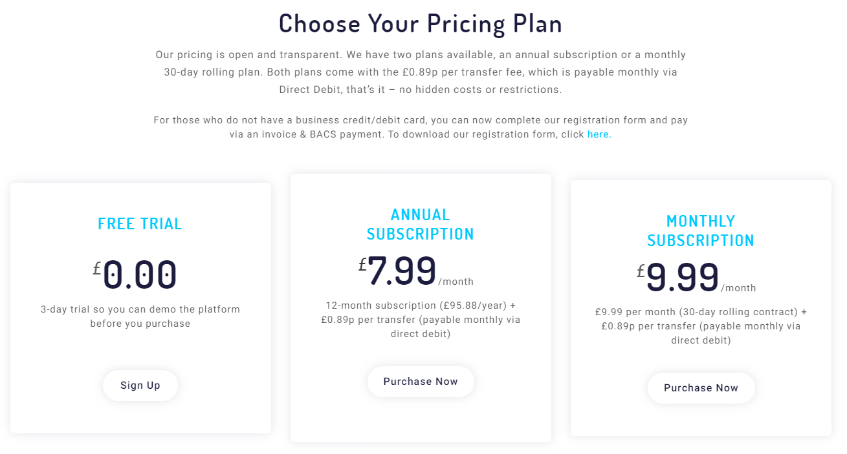
Pricing

Slide 14
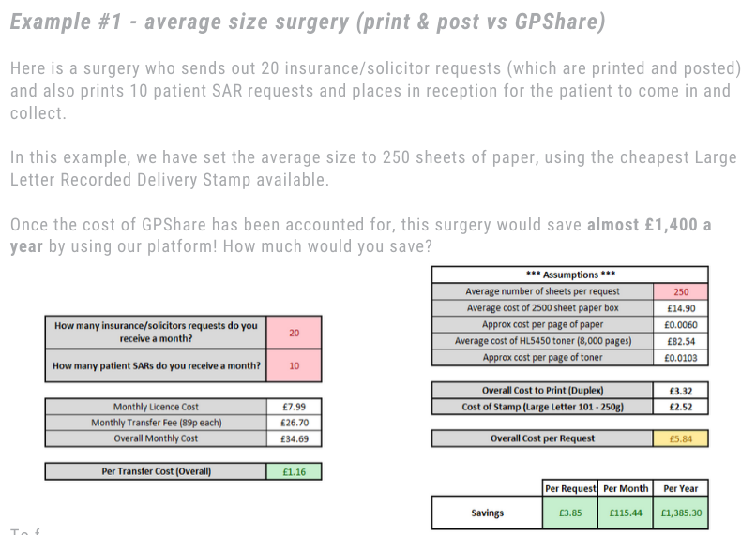
Savings – Average Size Surgery

Slide 15
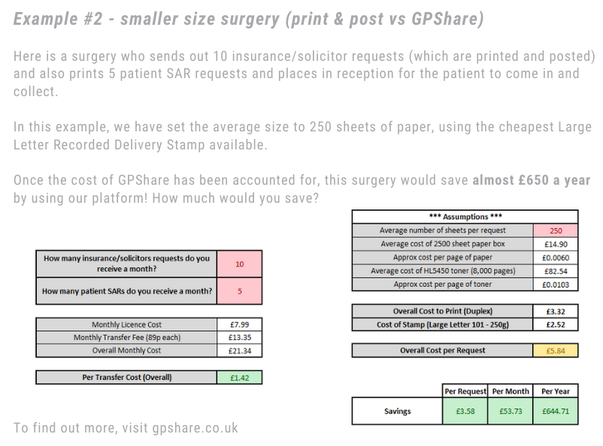
Savings – Small Sized Surgery

Slide 16
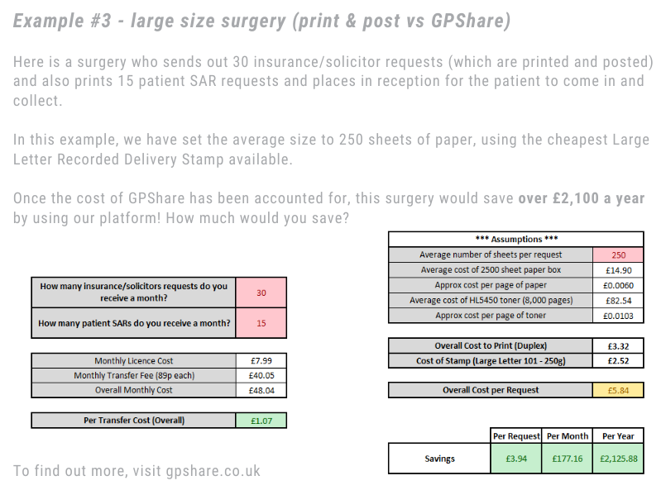
Savings – Large Sized Surgery

Slide 17
Service Guarantee
At GPShare, we truly believe our platform will save you money and make your business more efficient.
If for any reason you are not convinced that our platform is saving you money and making your business more efficient within the first 30 days, we will refund 100% of your subscription fee!
*Valid for all new customers who sign up before the 30th June 2020. Service Guarantee only valid for the first 30 days.

Slide 18
THANK YOU! info@gpshare.co.uk www.gpshare.co.uk
FB: fb.com/GPShareUK

Slide 19
Q&A

Slide 20
Thank you for joining!
Stay Safe! info@gpshare.co.uk www.gpshare.co.uk

